Slide 1
Clustering Algorithms in Unsupervised Machine Learning
Understanding clustering models and when to use them

Slide 2
Recap on Clustering
Clustering: Grouping similar data points without labels
Goal: Discover inherent structure in data
Real-world Examples:
Customer segmentation
Document classification
Anomaly detection

Slide 3
Why Clustering?
Used when labels are not available
Helps explore data structure
Applications include:
Marketing: Customer profiling
Image compression
Social network analysis

Slide 4
Types of Clustering Algorithms
Partitioning-based: K-Means
Density-based: DBSCAN
Hierarchical: Agglomerative/Divisive
Model-based: Gaussian Mixture Models (GMM)
Graph-based (optional): Spectral Clustering

Slide 5
K-Means Clustering
Steps:
Choose number of clusters (k)
Initialize centroids randomly
Assign points and update centroids iteratively
Pros: Simple, fast, scalable
Cons: Requires k, sensitive to outliers

Slide 6
DBSCAN (Density-Based Spatial Clustering)
Groups closely packed points using `eps` (Epsilon) and `minPts` (Minimum Points)
Epsilon is the radius around a point.
Minimum points defines how many points are required to form a cluster.
Finds arbitrarily shaped clusters
Pros: No need for k, handles noise well
Cons: Struggles with varying densities

Slide 7
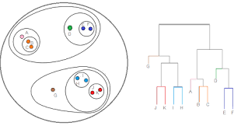
Hierarchical Clustering (A)
Types: Agglomerative (bottom-up), Divisive (top-down)
Builds a dendrogram (tree) of clusters
Pros: No need to specify k, gives insight into structure
Cons: Computationally expensive

Slide 8
Hierarchical Clustering (B) Agglomerative
Steps
Start with each data point as its own cluster.
Find the two closest clusters and merge them.
Repeat step 2 until all points are merged into one big cluster (the root of the tree).
Linkage Criteria determine how distances between clusters are calculated
Intuitive, simple to implement
Can visualize all levels of clustering via a dendrogram

Slide 9
Hierarchical Clustering (C) Divisive
less common approach.
Steps
Start with all data points in one cluster.
Split the cluster into two subclusters that are most dissimilar.
Continue recursively splitting until each point is in its own cluster.
Requires more complex logic to decide how to split clusters
More computationally expensive than agglomerative

Slide 10
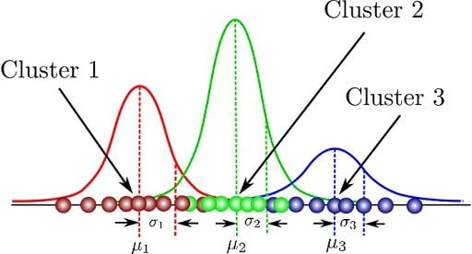
Gaussian Mixture Models (GMM)
Assumes data is from a mix of Gaussians
Uses Expectation-Maximization (EM) for soft clustering
A probabilistic cluster ie. "This point has a 70% chance of being in Cluster A and 30% in Cluster B.“
Pros: Probabilistic, handles elliptical clusters
Cons: Sensitive to initialization, assumes Gaussian shape

Slide 11
Choosing the Right Algorithm
K-Means: Fast, good for spherical clusters
DBSCAN: Handles noise, good for arbitrary shapes
Hierarchical: Insightful, but slow
GMM: Probabilistic, good for elliptical clusters

Slide 12
Summary
Different algorithms suit different data types
Key considerations:
Number of clusters
Shape and density
Noise and outliers
Always explore and understand your data first

Slide 13
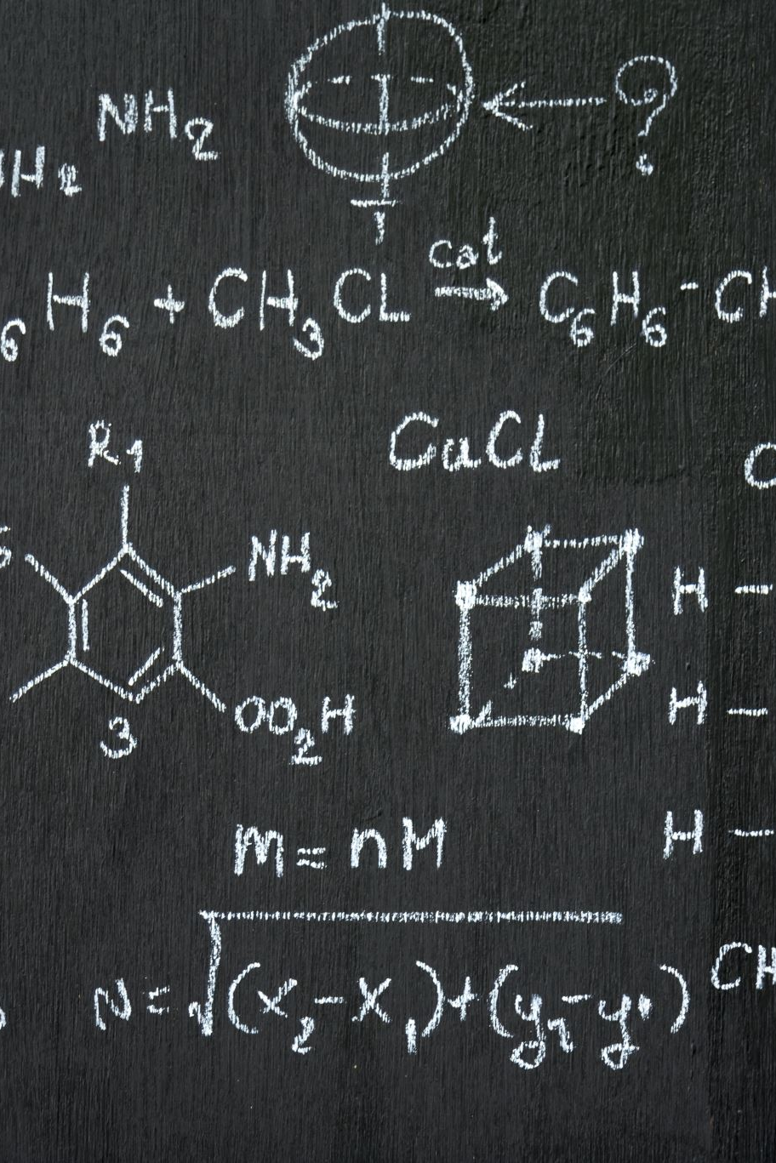
Activity
Compare and Evaluate clustering algorithms with and without a ground truth.
Page 191-194

